Slide 1

Coca in
Colombia
Assessing the eradication efforts of the world’s largest producer of cocaine
Martin Muñoz & Lois Wu

Slide 2
Brief overview
Colombia is infamously known to be the world’s capital of cocaine, an illicit drug, derived from the coca plant (Erythoxylon coca).
Since the 1980’s, coca cultivation is driven by poor, rural farmers; while guerillas and rebels are often holding the means of production and trafficking. Colombia, under both domestic and foreign pressure, has enacted multiple policies directed at reducing coca and cocaine production.
But how effective has it been?

Slide 3
Agenda
1.
Introduction and Background
2.
Issues and Research Problem
3.
The Research
4.
Policy proposals
5.
Risks and Conclusion

Slide 4
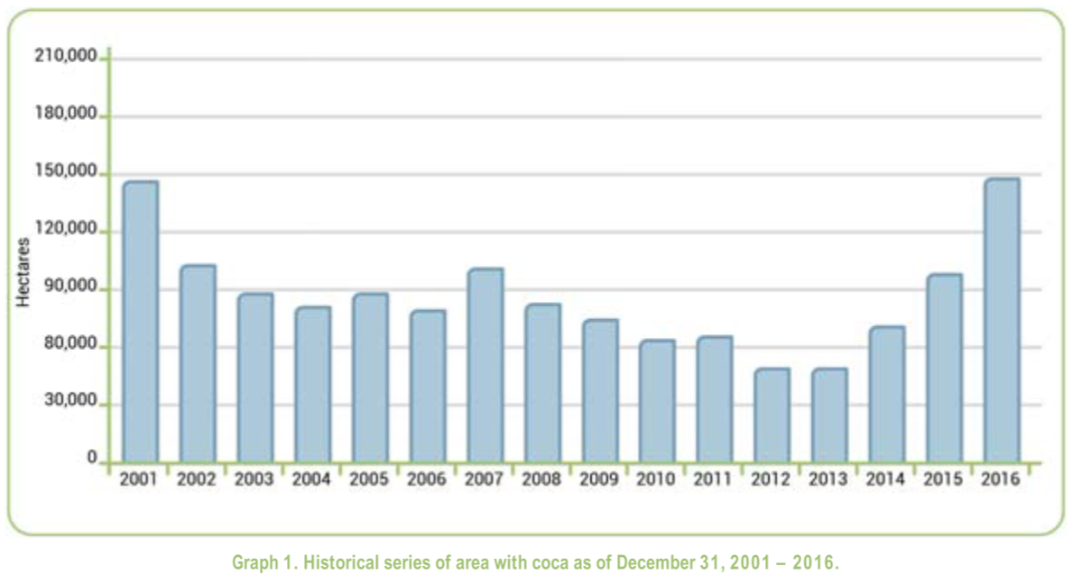
Issues
1
2
3
Cocaine production increasing.
Colombia produces >70% of world’s cocaine.
Despite seizure and lab destruction efforts, cocaine production is still increasing every year.
The acreage is increasing, but the regions affected decreasing.
Less communities affected, but those that are are more severely affected.

Slide 5
Issues
1
2
3
Coca profits.
Cocaine has high profit margins.
Drug traffickers can easily counteract the substitution programs by offering higher coca prices.
When crops are destroyed, farmers often replant same, if not more, acreage.

Slide 6
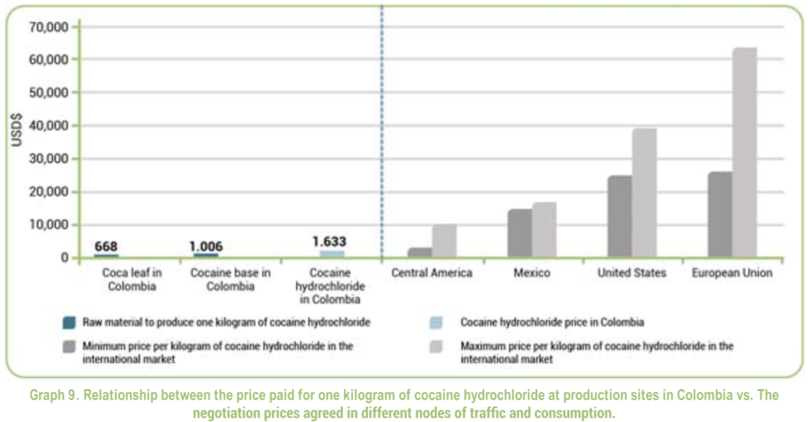
Issues
1
2
3
Also a demand issue.
European and North American demand drives cocaine production.
Demand policies are harder and more expensive to enforce, yet more effective at curbing cocaine in circulation.
USA pressure on Duque to resume aerial eradication, providing $400 million.

Slide 7
Actions
Aerial Eradication
Manual Eradication
Spraying glyphosate, an herbicide. Banned in 2015, reinstated in February 2020.
On-foot, uprooting or torching of plants. Exposes drug task forces to old FARC explosives.
Voluntary government subsidy programs, such as PNIS, which began in 2017.
Community, human development-focused. Overcome conditions of inequality.
Crop Substitution
Infrastructure

Slide 8
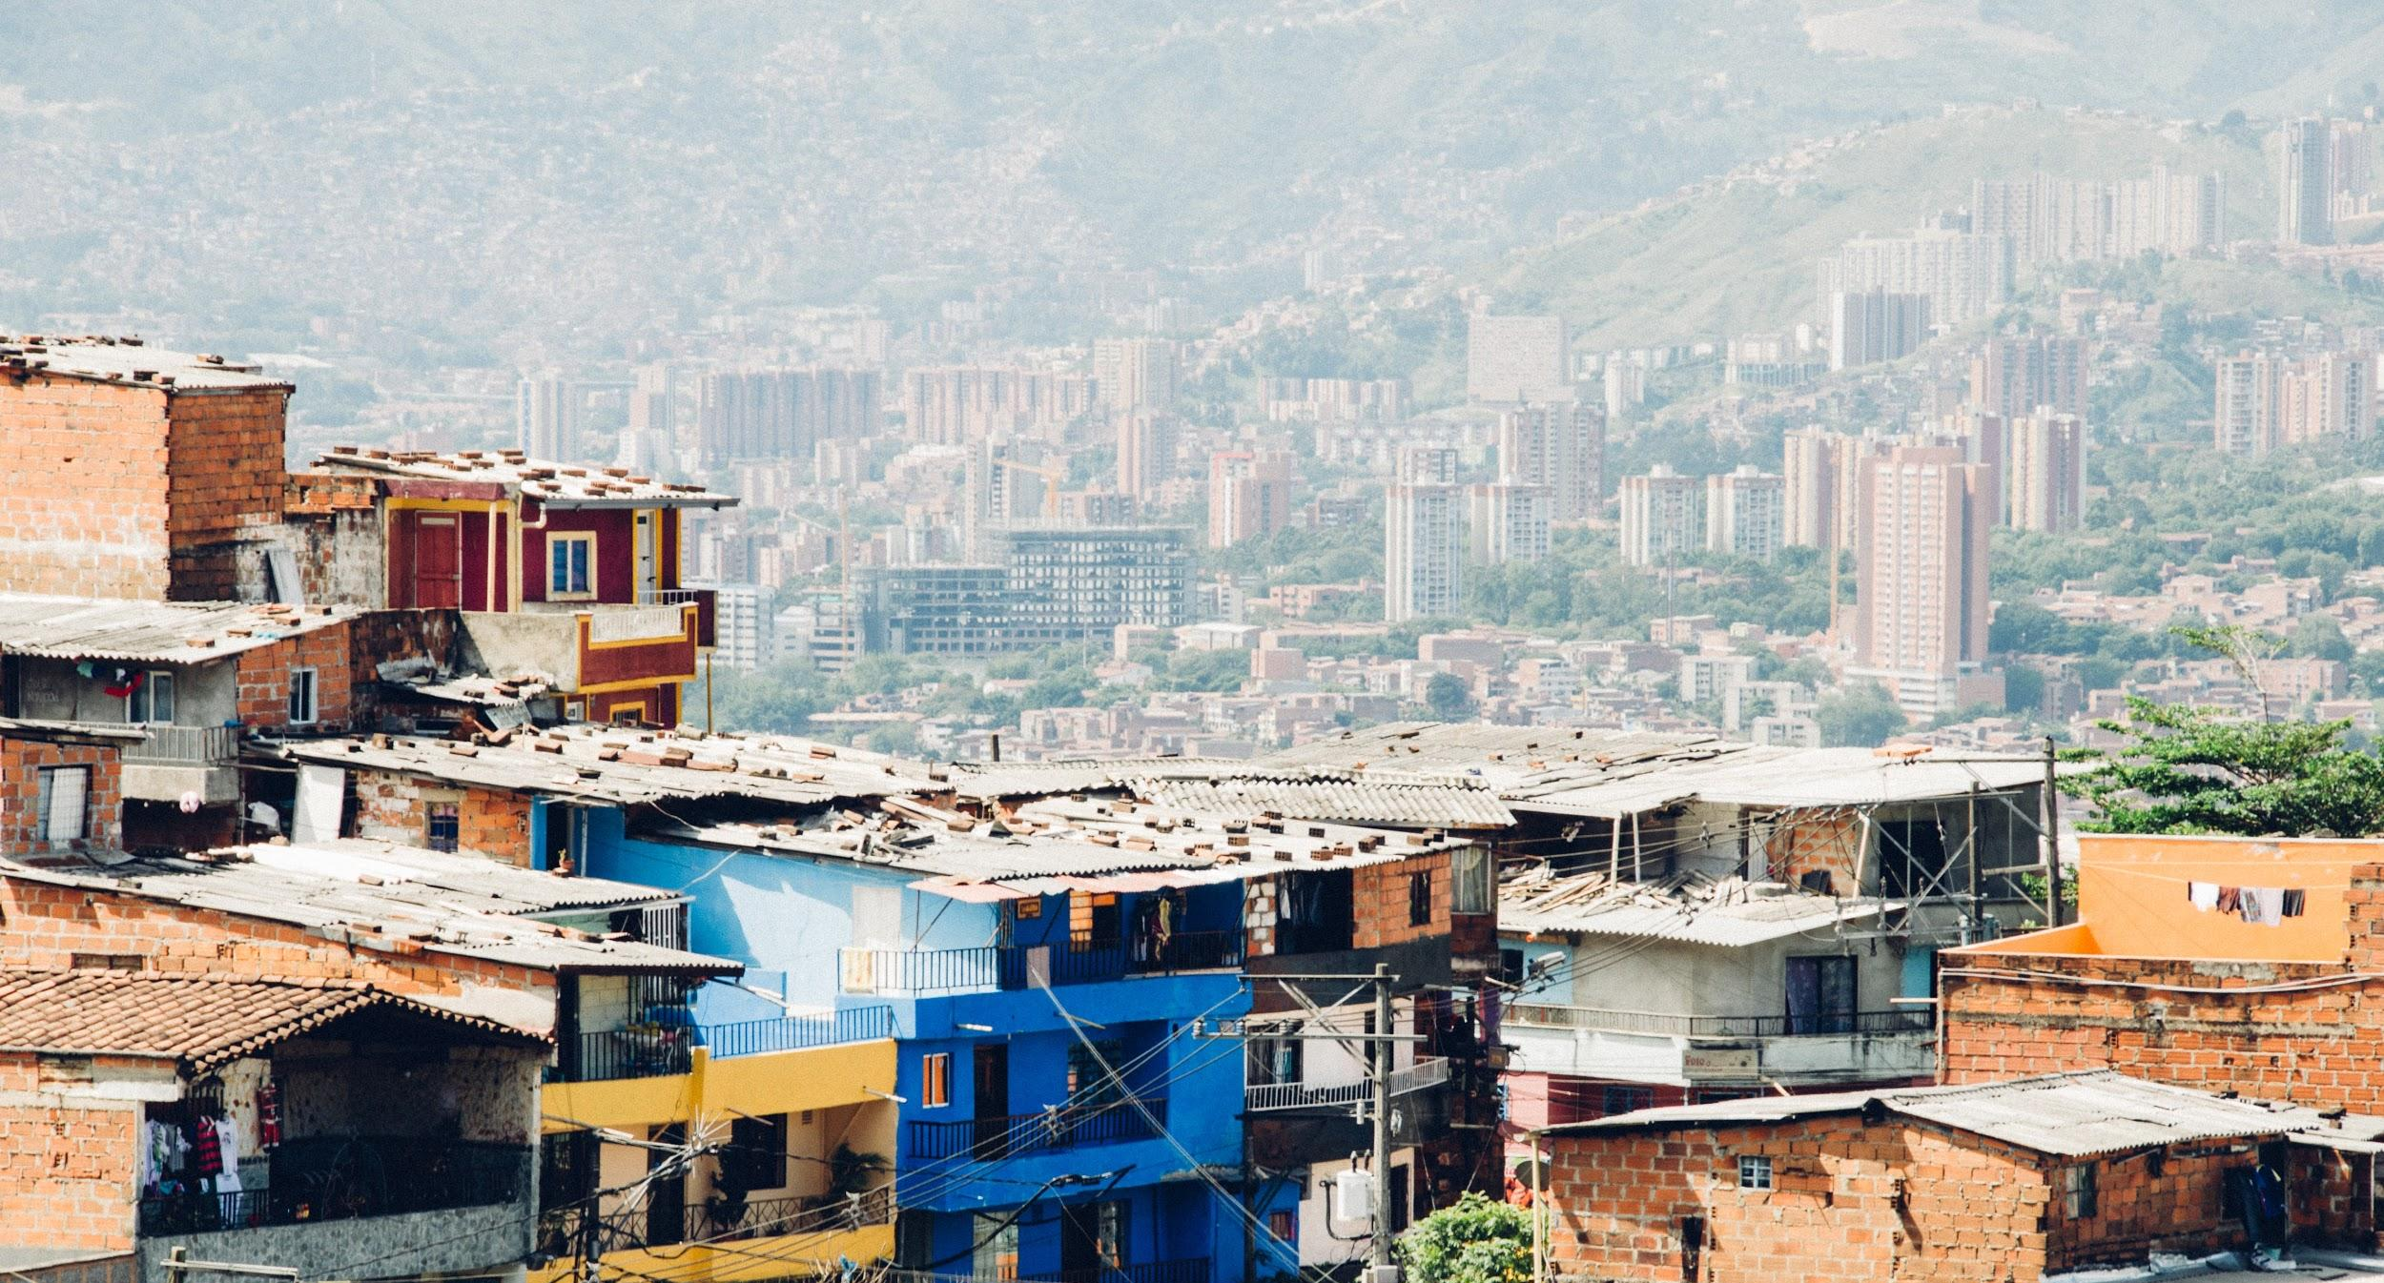
Variables
Years: 2002-2016 inclusive
Fixed Effects: 23 dummy variables for 24 regions.
Coca Production: Measured in hectares. Specified over time and region.
Cocaine Prices: europe cocaine wholesale prices. Measured in US$/kg. Inflation adjusted to 2020 euros and purity adjusted. Specified over time.
Agriculture: production index calculated by FAO, adjusted to 2004-2006 levels. Specified over time.
Unemployment: Specified over time and regions
Eradication: Measured in hectares. Specified over time and region.
360 observations of 29 variables

Slide 9

Model Specification
a_{i} = B_{o}+ B₅Z_{i}
Z_{i} = a vector of fixed effects for 24 departments
B₁= eradication by region and time
B₂= cocaine prices by time
B₃= agricultural index by time
B₄= unemployment by region and time

Slide 10
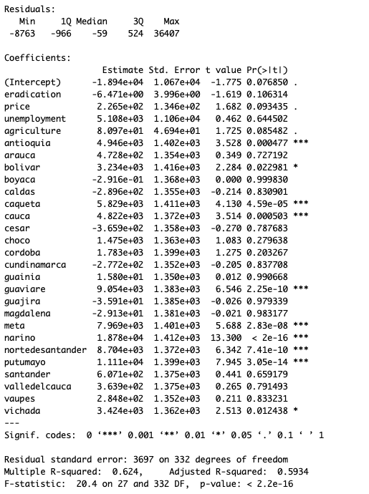
Results
Price and agriculture significant at the 5% level
Coefficient for price has an intuitive sign, but one for agriculture is surprising
Eradication, unemployment were not significant
Significant fixed effects?

Slide 11
Policy changes
1
Demand-focused policy
2
Support voluntary programs
Drug policy experts traditionally focus on supply side policies, but these have been relatively ineffective in Colombia.
Colombia should continue policies, but also pressure countries that drive demand-–US and Europe––to invest in demand-side policies to combat drugs through prevention, treatment, and enforcement.
The cocaine market is a supply and demand issue.
Voluntary eradication programs, whereby farmers receive support from the government to transition to new crops
Has been effective in other countries, such as Thailand and regression shows that agriculture has a statistically significant effect on coca production
Largest crop substitution program began in 2017, but is dealing with inefficiencies. Too early to tell outcome.
Should be coupled with developing infrastructure to access legal markets in order to improve base welfare.

Slide 12
Conclusions, Next Steps
Outcome
Model has shown that involuntary eradication is ineffective.
But agriculture has an effect on coca production, so voluntary crop substitution may work. In addition, explore demand-side policies, alongside infrastructure changes.
Next steps
Given that demand-side policies are difficult to implement, it is more likely that the solution will need to come from programs like PINS. Should focus on ameliorating the program, and–as a last resort–exploring demand-side policies. Exploring the effect of agriculture on coca production more deeply.
In addition, economic security for farmers must be ameliorated to reduce incentive to plant coca.

Slide 13

Questions?

